Slide 1
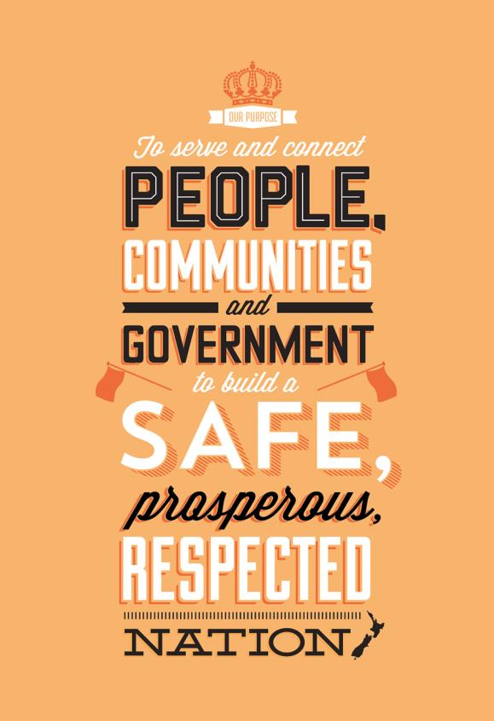
Funeral Directors Association of NZ
Jeff Montgomery
Registrar-General and General Manager of Te Ara Manaaki

Slide 2
Death registration
Notes:
This is the number of death registrations completed per month, based on the date the registration is completed. This is in line with our regular reporting.
Deaths usually have a seasonal peak in winter, but 2020 has been unusual in this regard. Because of COVID-19 related lockdowns and associated behaviour, the seasonal peak was non-existant. This was mainly due to the lack of the usual winter flu and pneumonia season.
https://www.thelancet.com/journals/lancet/article/PIIS0140-6736(20)32647-7/fulltext
https://www.rnz.co.nz/national/programmes/sunday/audio/2018767843/near-extinction-of-influenza-in-nz-as-numbers-drop-due-to-lockdown

Slide 3
Online uptake of death documents
Notes:
This is the number of death registrations received, based on the insertion date into Lifedata. For online registrations, the insertion date and received date will be the same as registrations are immediately pushed from the online system into Lifedata and for paper registrations this should also always be the same, as they are data entered on the day we receive them, this ensures we can meet our SLA for death registrations.
The vast majority of death registrations are received online. Almost all funeral directors submit death registrations online. Most paper registrations will be forms submitted by people who are in charge of the burial/cremation, but who are not funeral directors.
The online uptake figure has been estimated based on the number of paper registrations received as a proportion of all registrations received. The paper number is a manual count taken from a spreadsheet, but we are reasonably confident in it's accuracy and as such this estimate should be robust.

Slide 4
Online volume of death documents
Notes:
This is the number of deaths that occurred, based on the date of death as recorded on the registration, compared to the number of deaths notified to the Ministry of Health via the Death Docs service. The Death Docs figures come from the Ministry of Health and are also based on the date the death occurred.
The Death Docs figures from Ministry of Health only go back to March 2018, so our figures have been aligned to these dates. Online uptake for this service has overall steadily increased over time, but had it's sharpest increase around the beginning of the COVID-19 pandemic, and has plateaued since.

Slide 5
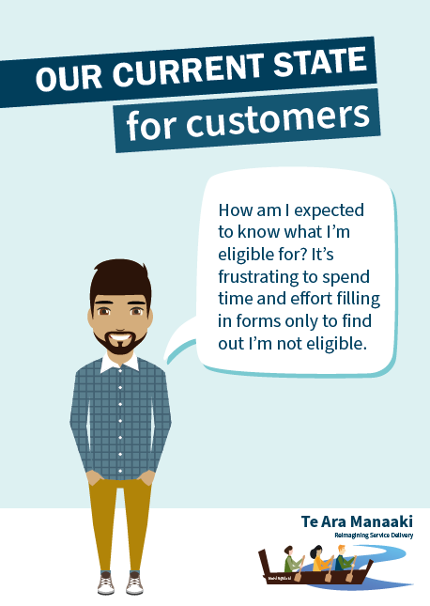
Te Ara Manaaki – current state
Notes:
Re-imagining and re-designing our life event and identity services around the needs of our customers and their whānau
New Zealanders increasingly expect to interact and complete transactions with Government as simply as they would when banking, booking flights or communicating through social media
We’re achieving this through Te Ara Manaaki – a two-phase programme of work and Departmental priority

Slide 6
Te Ara Manaaki
Re-imagining our life event and identity services around the needs of our customers and their whānau
New Zealanders increasingly expect to interact and complete transactions with Government as simply as they would when banking, booking flights or communicating through social media

Slide 7
Phase 2 – 2021-25
Second phase has begun and will continue for five years
Phase 2 has four streams:
Civil Registration (BDM)
Becoming a New Zealander (Citizenship)
Travel Documents (Passports)
Digital Identity & Interactions
Notes:
This investment will:
shore up New Zealand’s national life and identity data infrastructure
enhance the value of personal identity information
empower people to use and control their personal data
implement service foundations that are safe, flexible, and scalable to meet the needs of digital government
improve access to public services for individuals and their whānau and those acting on their behalf

Slide 8
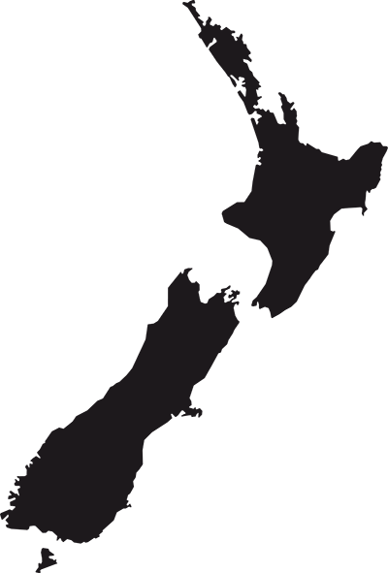
What’s next?
Death AISA consultation and Iwi engagement
Engagement about the future of death registration (and BDM as a whole)
What does Te Ara Manaaki’s mahi mean for funeral directors? An opportunity for blue sky thinking
Starting the conversation at FDANZ Conference, in FuneralCare and maybe in peer support groups

Slide 9
“Kei a tāua mana to mauri Kei a tāua mauri te mana”
“Our interactions and purpose brings life Our exchange of life brings purpose”

